Slide 1
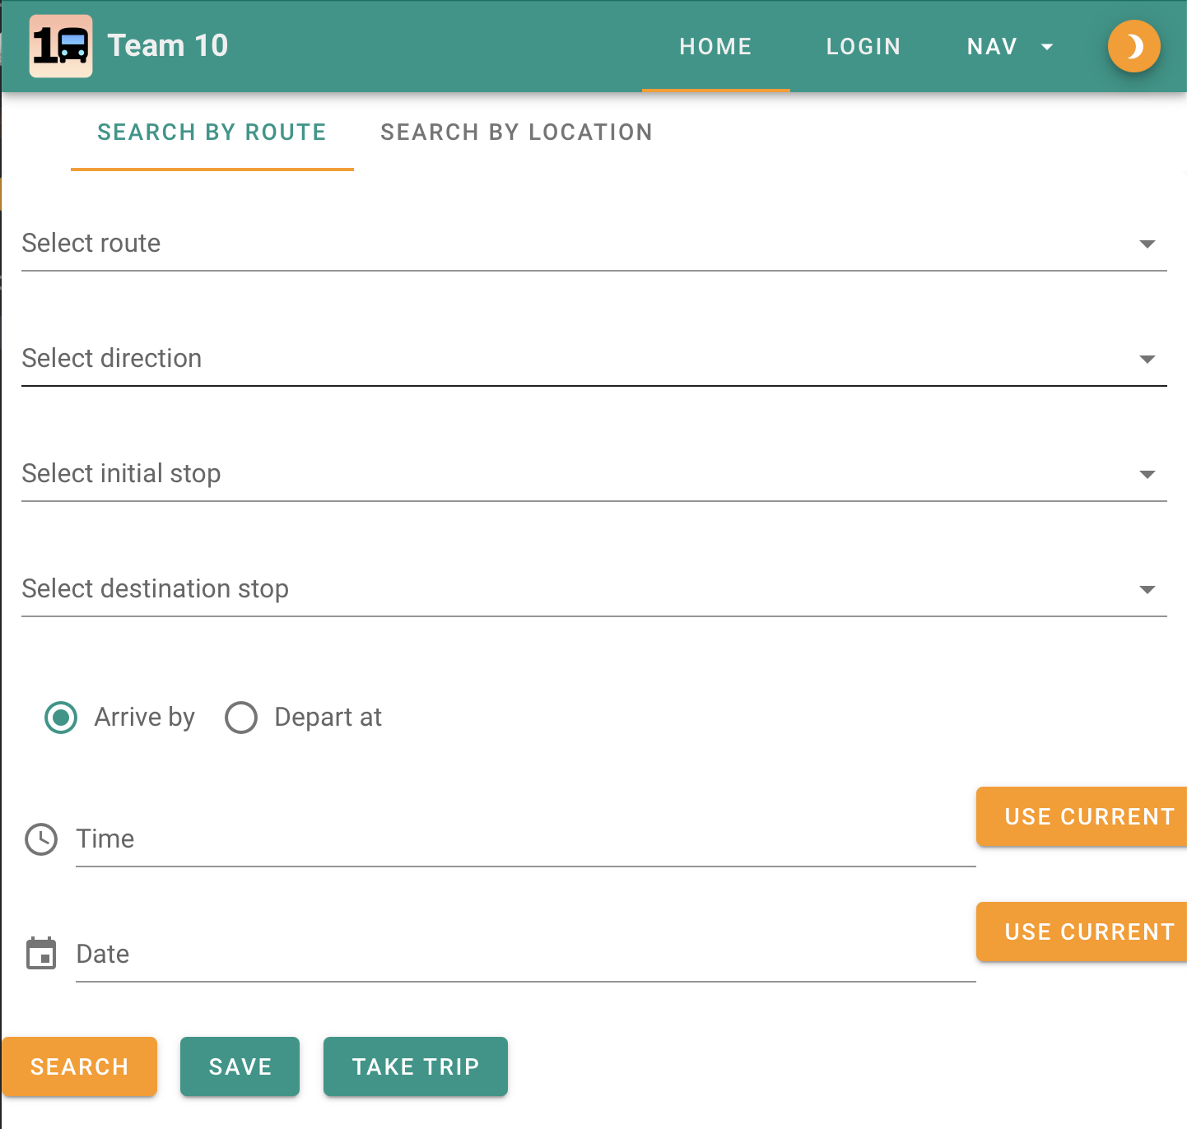
Dublin Bus App Relaunched
Fig. 1: Team 10’s Home Page
Team 10 - Team Members:
Daniel Danev - Coding Lead - Front-end Developer
Danning Zhan - Maintenance Lead - Data Analyst
Turlough Hannon - Coordination Lead - Full-stack Developer
Adam Ryan - Customer Lead - Back-end Developer

Slide 2
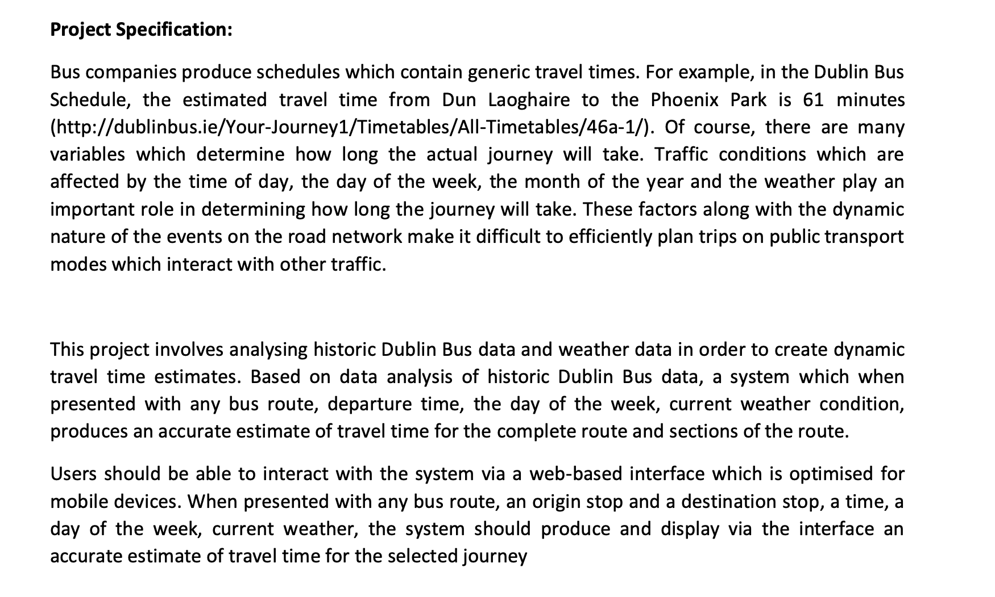
1. PROJECT SPECIFICATION
Fig. 2: The Project Specification

Slide 3
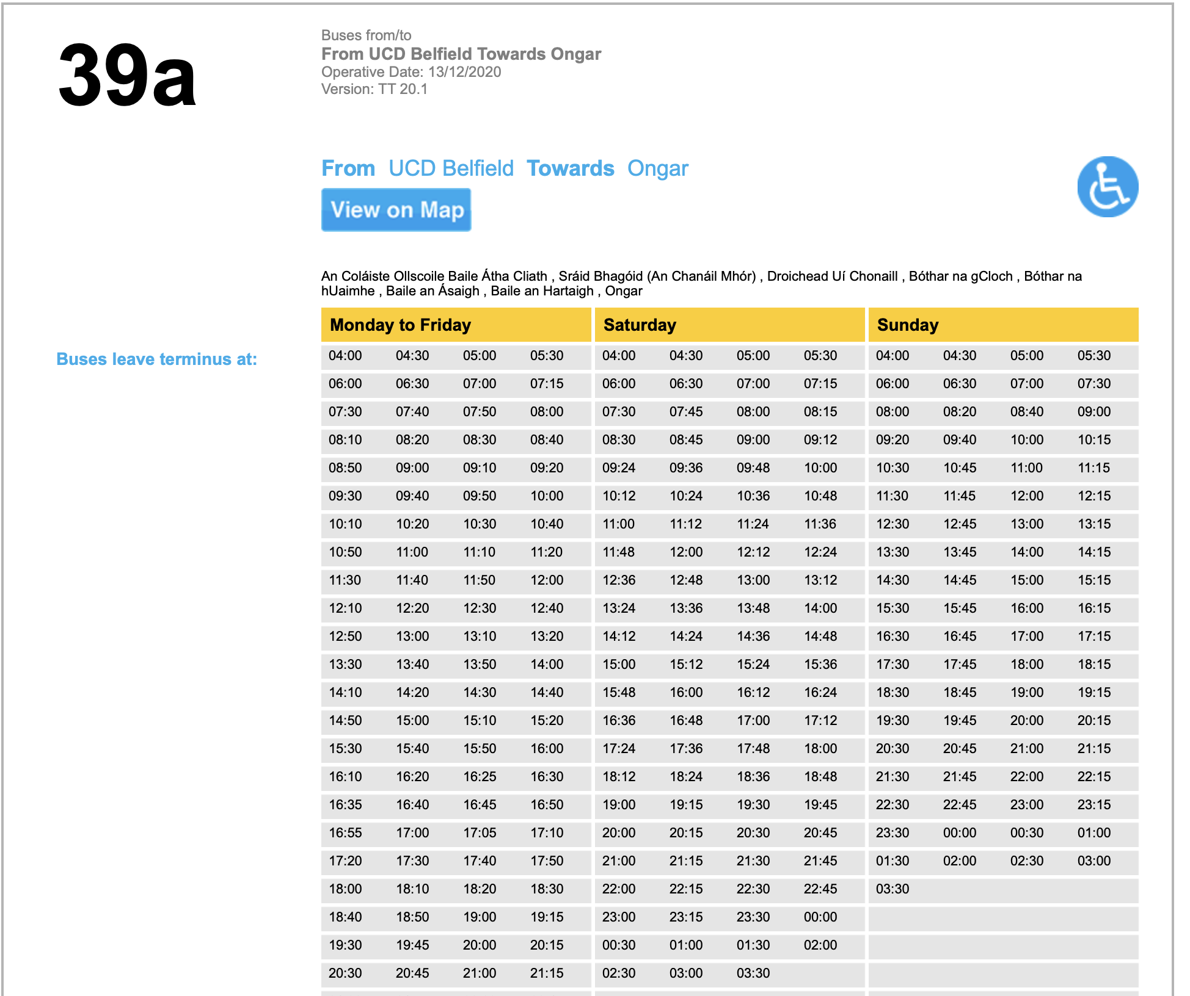
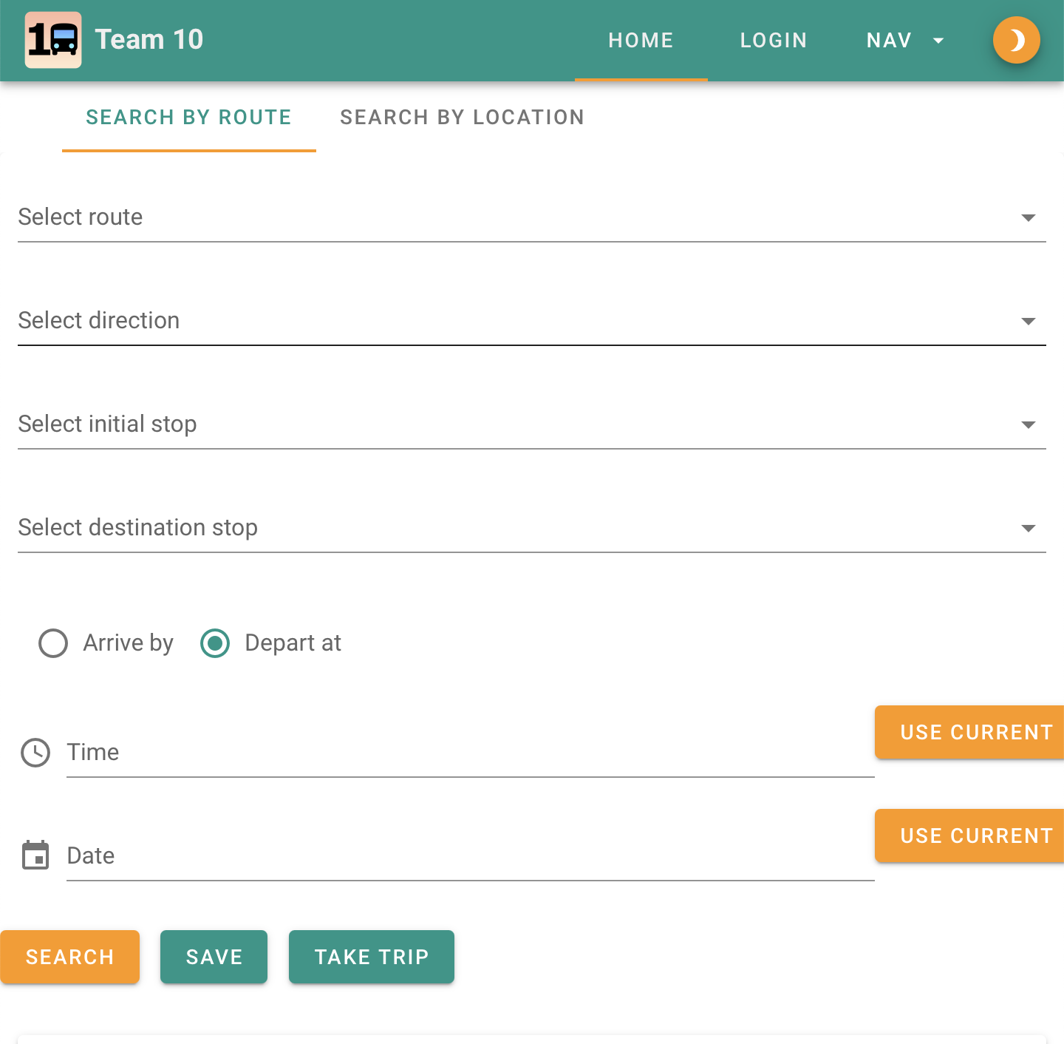
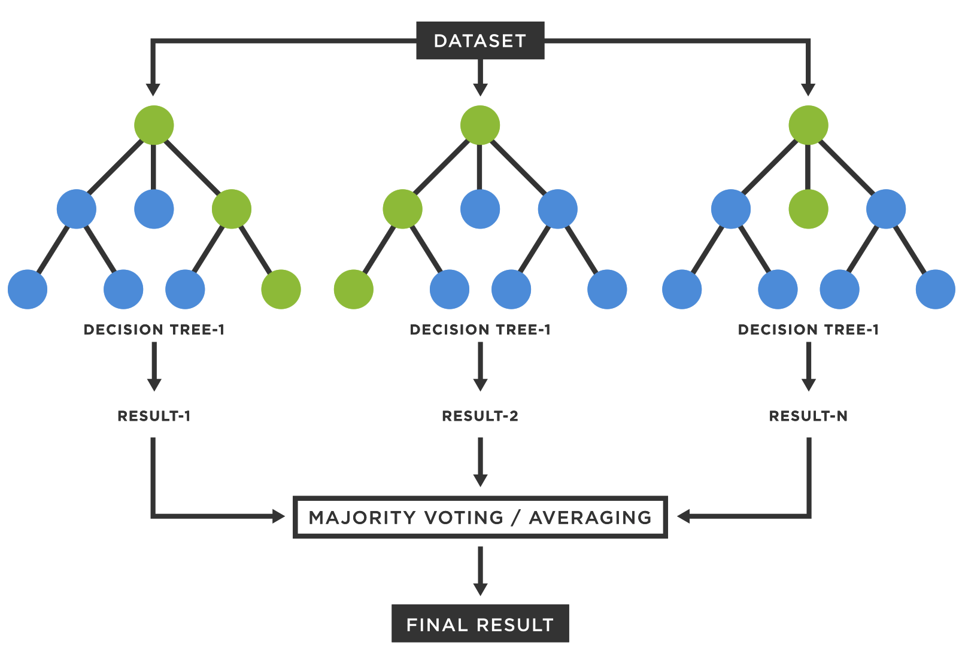
2. HOW DO I GET TO UCD?
Existing Solutions Exist
Not User Friendly
Inaccurate or Generic Times
Poorly Reviewed
May not be focused solely on Dublin Bus (Moovit, Google)
Our Solution
Powered by Random Forest Models trained on Weather and Route History
Intuitive UX with Quality of Life Features Powered by Vue Components
First Irish Travel App with Gamification based on Sustainable points.
Fig. 3: Dublin Bus Timetable
Fig. 4: Dublin Bus Timetable
Fig. 5: Random Forest Models

Slide 4
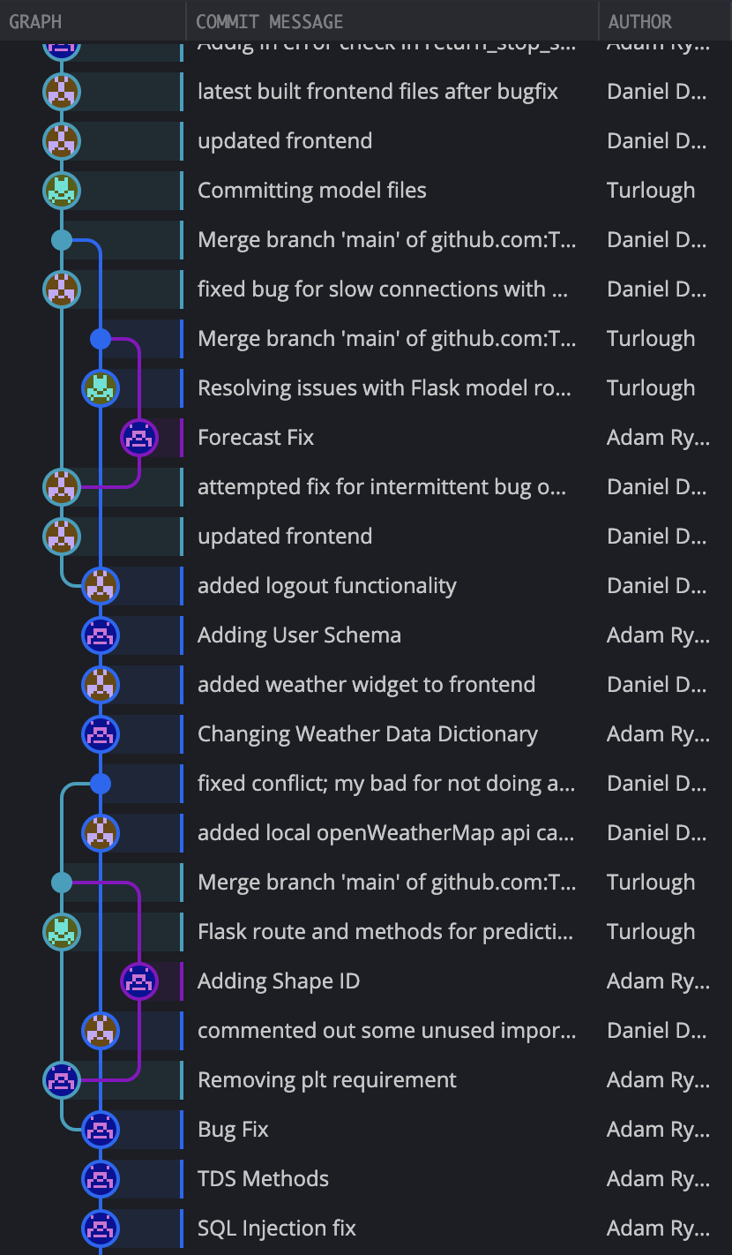
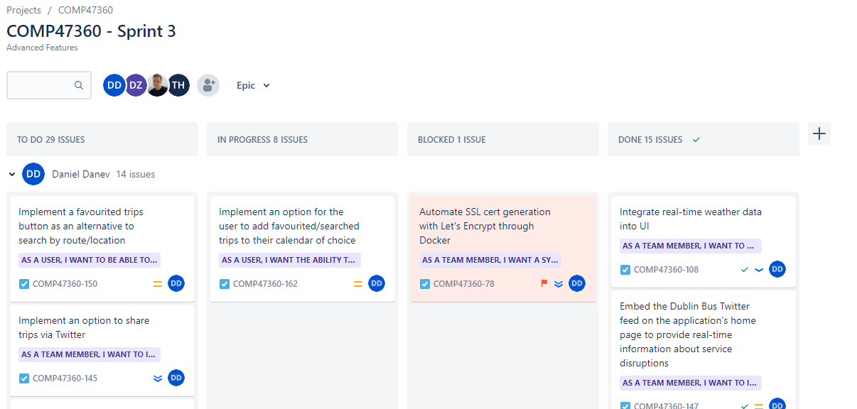
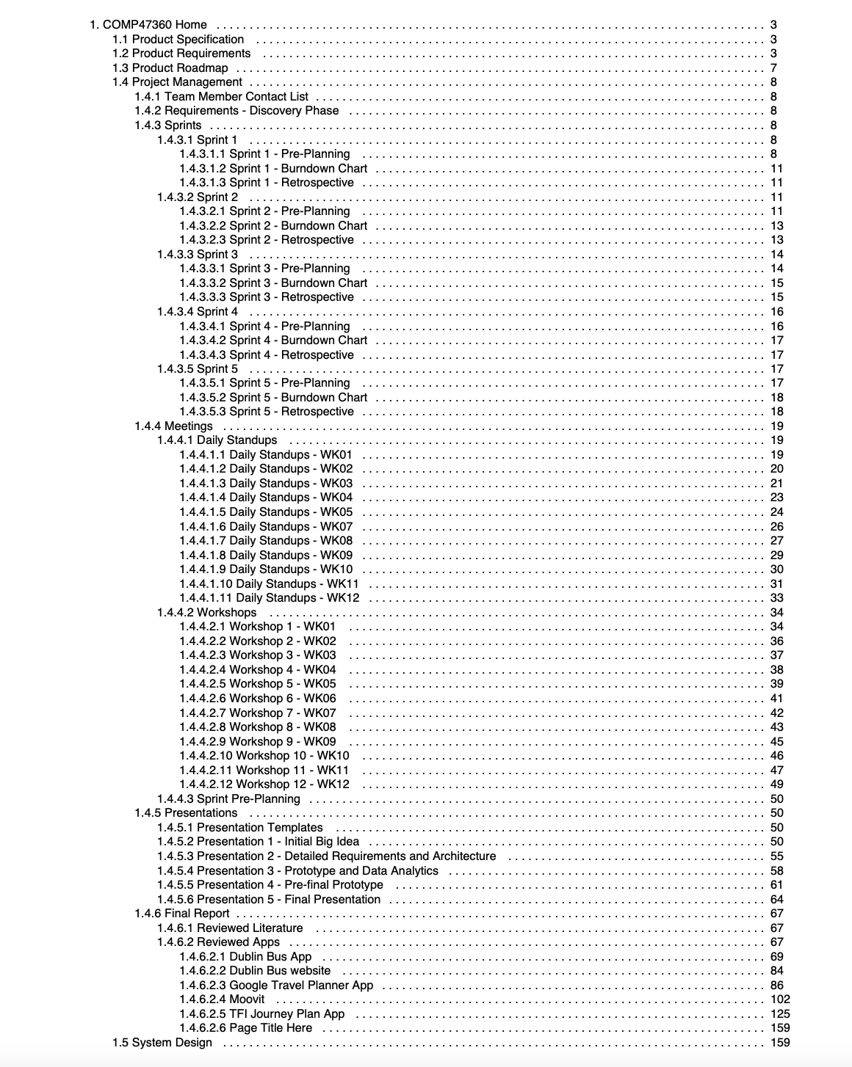
3. DEV PROCESS AND ARCHITECTURE
Project preferences to areas of speciality
Chosen preferences had little bearing on work done
New preferences on Interest and Experience.
Project management
GitHub, Jira, Confluence
Regular communication (standups, sprint plans)
Architecture grew out of group strengths and knowledge
Fig. 6: Sprint 3 - Jira Snapshot
Fig. 7: Confluence Structure
Fig. 8: Centralised Git Repo Structure

Slide 5
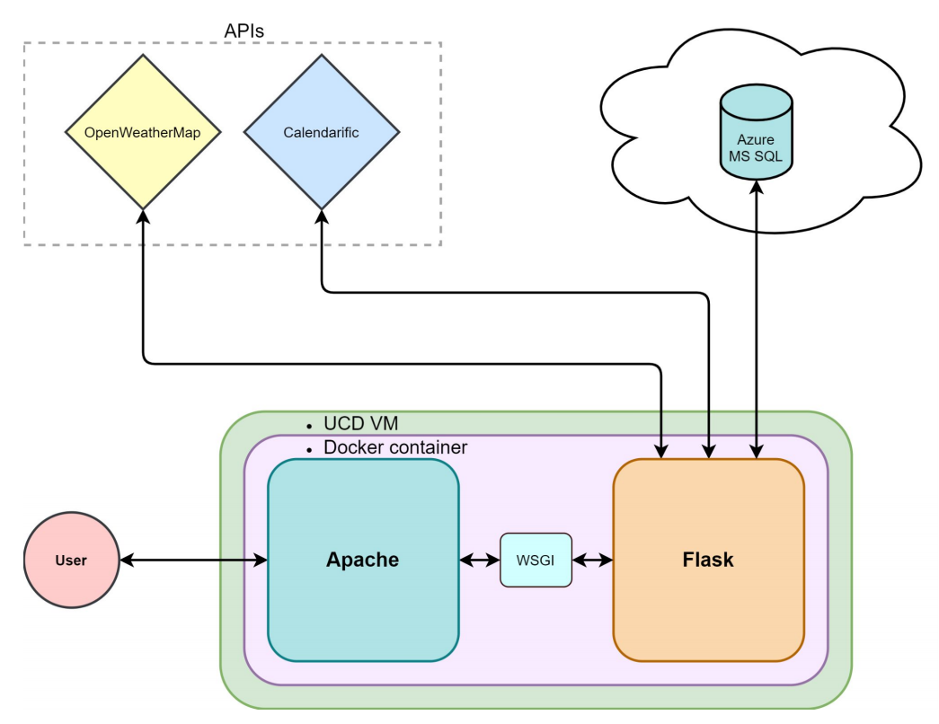
3. DEV PROCESS AND ARCHITECTURE
Modern Tech Stack
Vue
Apache
Flask
Docker
Azure
Lightweight Stack
Flexibility in Development
Aligned with Team Experience and Project Preferences.
Fig. 9: High-Level System Architecture

Slide 6
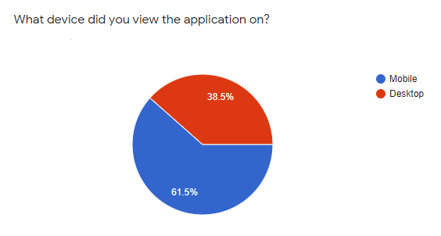
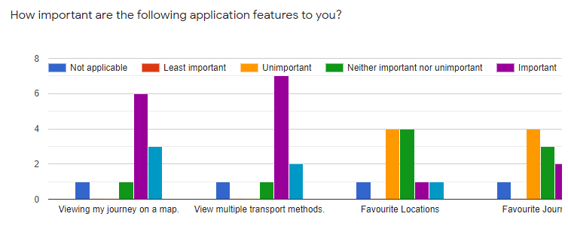
4. INITIAL FEEDBACK FROM SURVEYS
A focused group of responders provided valuable feedback
Most feedback was positive
Our incorporated features were generally positively-viewed
Feedback on possible future features gathered
Valuable suggestions put forward regarding site layout
Future work
Development of backlogged features
Admin Dashboard
Google Analytics Integration
Embedded Survey Form
A/B Testing
A continuous cycle of improvement
Recording of Model Outputs
Refinements and bugfixes
Model Expansion
Additional Error Handling
Fig. 10: High-Level System Architecture
Fig. 11: Application Feature Importance

Slide 7

5. QUESTIONS AND ANSWERS
Thank you for your time.
All questions are welcomed.

